Slide 1


Software Testing and Verification
Midterm Presentation
NOTES
DAILY NOTE -
每日筆記/日誌
指導老師：劉建宏 老師

Slide 2

第1組
Member
111C72008 蘇柏瑋
111598027 童柏鈞
111598044 曹慶宥
111598059 林家同
111598066 許哲維
Date
2023/04/26

Slide 3
Outline
01
02
03
04
05
06
07
Introduction
Features to be Tested
Test Criteria
Test Approach
Activities and Schedule
Testing Tools
Responsibilities

Slide 4
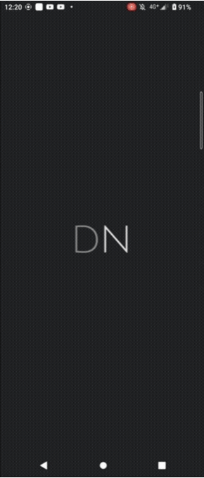
Introduction
「DAILY NOTE - 每日筆記/日誌」是一款方便易用的日記應用程式，可以讓用戶輕鬆記錄自己的日常生活、情緒和想法。主要特色如下：
簡單快速的記錄
在書寫時添加圖片
支援多種外觀(字體、背景)
在日曆中查看所有筆記

Slide 5
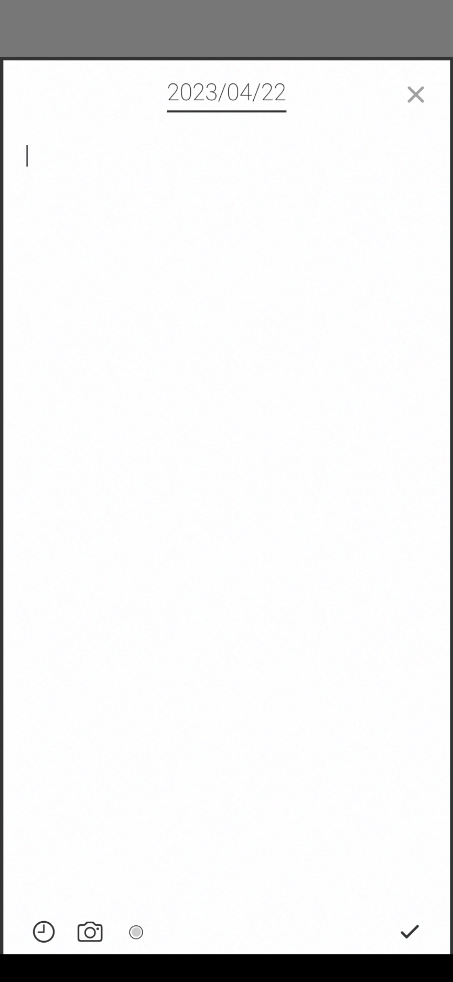
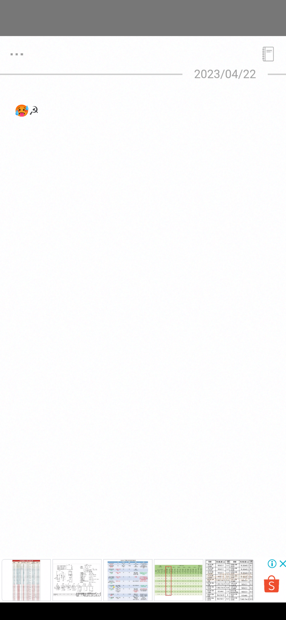
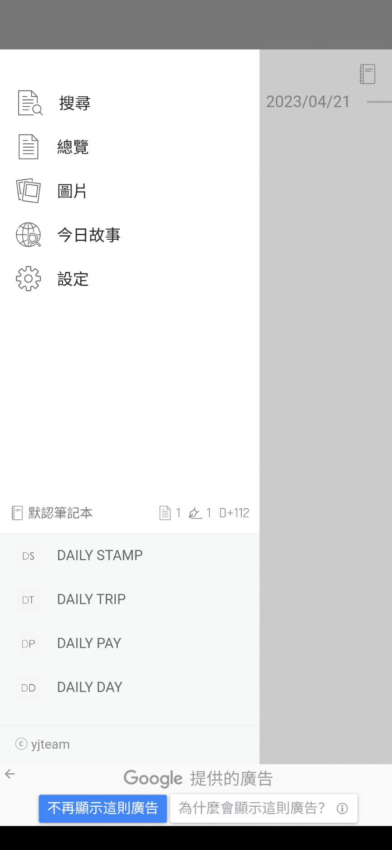
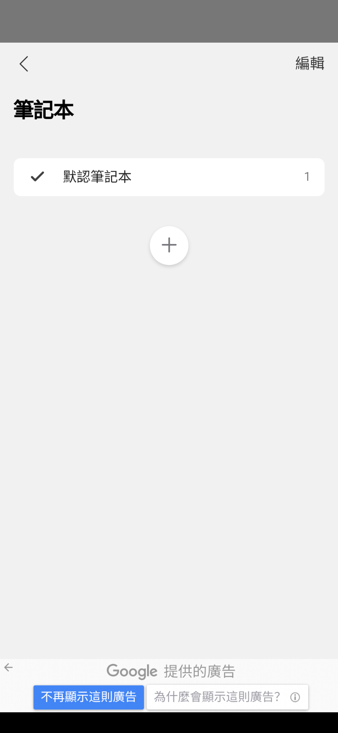

Slide 6
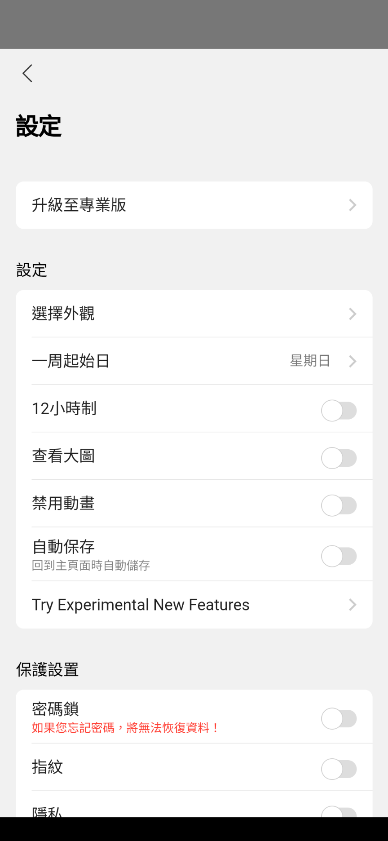

Slide 7
Features to be Tested
Feature | Description
Note Created | 建立筆記內容，並選擇是否插入圖片、時間、編輯標籤等等。
Note Updated | 編輯筆記內容，包括文字、圖片、更換標籤等等。
Note Deleted | 刪除筆記內容(文字、整篇日記)。
Note Sorted | 排序已編輯的日記。
Image Show | 顯示已加入筆記的圖片。
Setting Skin | 設定筆記背景與字體。
Setting Image | 設定插入筆記之圖片大小。

Slide 8
Features to be Tested
Feature | Description
Setting Lock | 設定筆記密碼鎖。
Setting First Day of Week | 設定一週的起始日。
Story Language Only | 限定今日故事的語言。
Story Copy or Save | 複製今日故事的內容或保存故事。

Slide 9



Test Criteria
1. Code coverage (Feature to be tested) 達到 70%
2. 所有 Test Case 達 85% 以上通過
3. Priority 1 & 2 的測試需全部通過

Slide 10


Test Approach
我們預計使用Input Space Partition(ISP)以及User Scenarios來設計測試。

Slide 11

ISP
[ID]Name | [TC-03]Note Created | Infeasible TRs | None
Characteristic ID | C1, C2, C3 | Revised TRs (ECC) | None
Characteristic Description | C1: input content C2: insert image C3: click insert time | Test Cases (ECC) | T1: {“”, png格式, false, expected result: valid}, T2: {“Test#123”, jpg格式, true, expected result: valid}, T3: {“ ”, jpg格式, false, expected result: valid} T4: {“☭”, jpg格式, false, expected result: valid}
Partitions (Blocks) | C1:{none, 一般字元, 表情符號, 特殊字元} C2:{jpg格式, png格式} C3:{true, false}
Test Requirements (ECC) | {none, png格式, false}, {一般字元, jpg格式, true}, {表情符號, jpg格式, false}, {特殊字元, jpg格式, false} | Memo (ECC) | T1 covers {none, png格式, true}, T2 covers {一般字元, jpg格式, true}, T3 covers {表情符號, jpg格式, true}, T4 covers {特殊字元, jpg格式, false}

Slide 12

User Scenario
Background
Motivation
Tasks
Name: Lucy
Age: 22
Gender: Female
Occupation: Student
撰寫日記，紀錄生活的點滴，並可以儲存相片和當下時間當作備忘錄，紀錄未來要做的事情。
選擇日期
新增文字日記和圖片
刪除和修改日記內容
查看別人的日記

Slide 13
Activities & Schedule
Date | Time | Event | Member
2023/03/11 | 3hr/person | Study project | All
2023/03/11 | 5hr/person | Study test tools | All
2023/03/18 | 6hr/person | Phase 1: Write STP | All
2023/03/25 | 3hr/person | Phase 1: Write SUT | All
2023/04/08 | 8hr/person | Phase 2: STP Revision Phase 2: Write TDS | All
2023/04/22 | 3hr/person | Midterm Presentation: Preparing slide | All

Slide 14
Activities & Schedule
Date | Event | Member
2023/04/29 | Phase 3: Write TCS | All
2023/05/06 | Phase 3: Revise ptt slide of midterm presentation | All
2023/05/13 | Phase 3: Revise STP & TDS | All
2023/05/20 | Phase 3: Partial implementation of TCS as test scripts | All
2023/05/27 | Phase 4: Revise TCS Phase 4: Implement TCS | All
2023/06/03 | Phase 4: Perform the functional testing for SUT Phase 4: Report Bugs | All

Slide 15
Activities & Schedule
Date | Event | Member
2023/06/10 | Phase 4: Analyze test result Phase 4: Submit test result summary | All
2023/06/17 | Final Presentation: Preparing slide | All

Slide 16





Testing Tools
appium
Robot Framework
Python

Slide 17
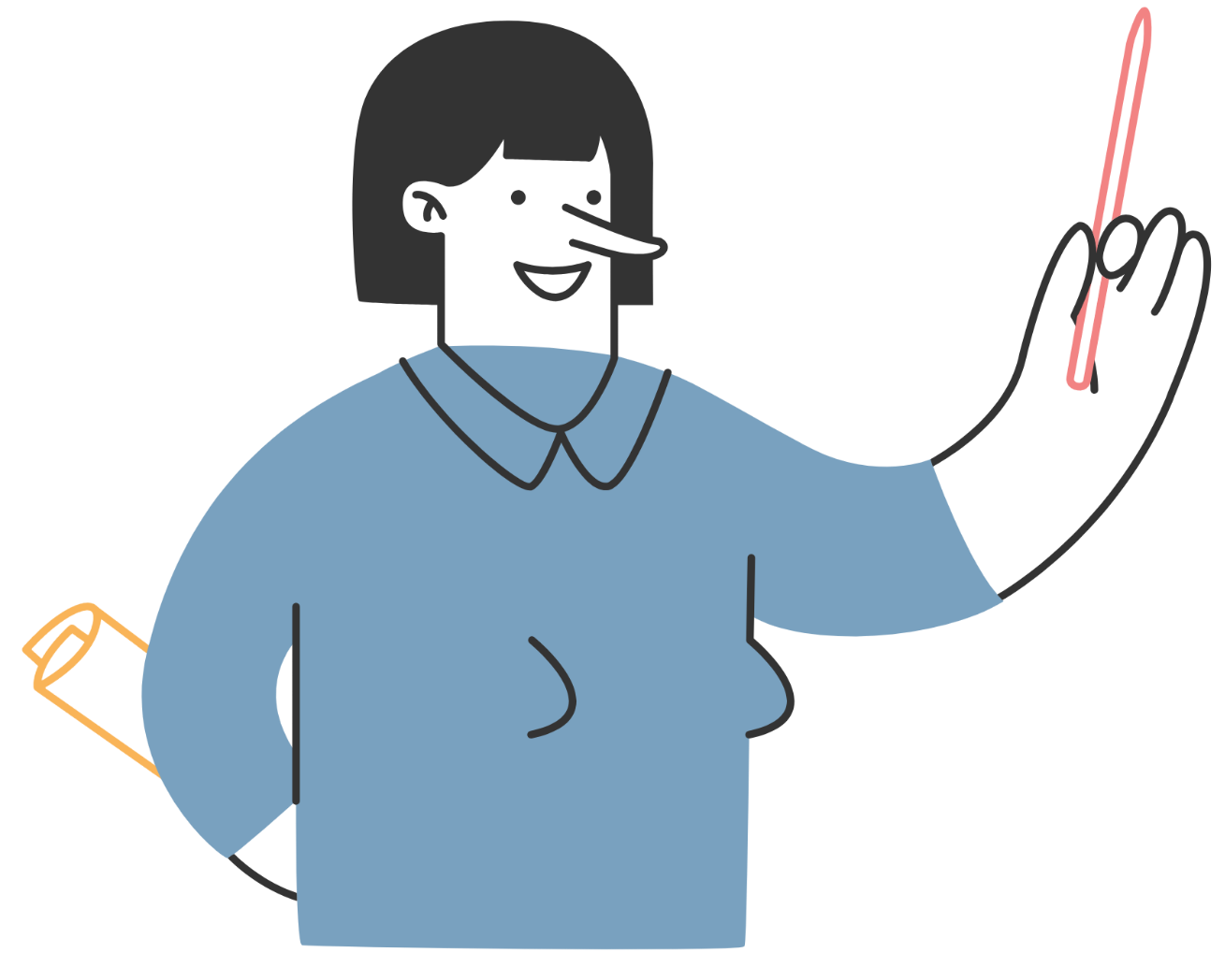
Responsibilities
蘇柏瑋 | 20%
童柏鈞 | 20%
曹慶宥 | 20%
林家同 | 20%
許哲維 | 20%

Slide 18
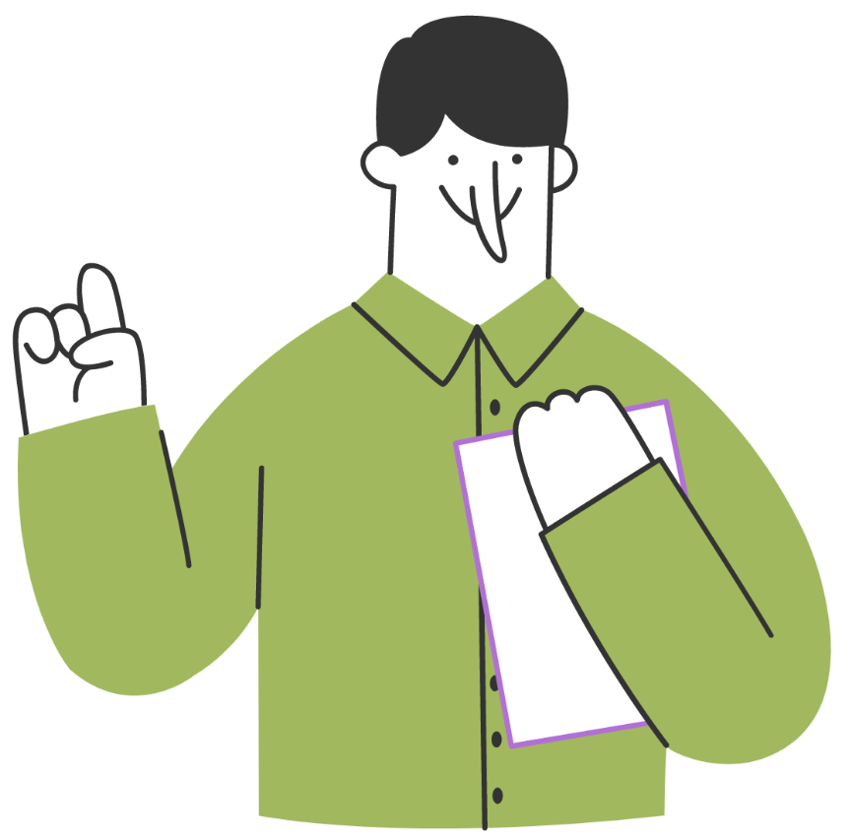
THANKS!

